Slide 1
Scala for Big Data: The Big Picture
Big Data / AZURE / AWS / Data Lakes
Anna-Maria Wykes
Data Engineering & Cloud Consultant

Slide 2

Who am I?
Senior Advancing Analytics Consultant specializing in Data Engineering & Cloud
A Software Engineer/Developer for 14 years’, most recently working with Scala, Kafka and various cloud tech at OVO Energy.
Prior to this I spent over 2 years working for a Microsoft Partner, championing a cutting-edge Data Science Project, aided by a variety of Azure tools, including Data Factory, Data Lake Gen2 and AKS.
I have a BSc in Multimedia Computing & Business, and a HND in Visual Communication
@annawykes
anna-maria-wykes-31939454

Slide 3
What makes me tick?
I have a passion for Data and strive to bring the worlds of Software Development and Data Science closer together.
I have helped to organize/run local Code Clubs
I help organize and volunteer at local events
Other areas of interest include UX, and Agile methodologies

Slide 4
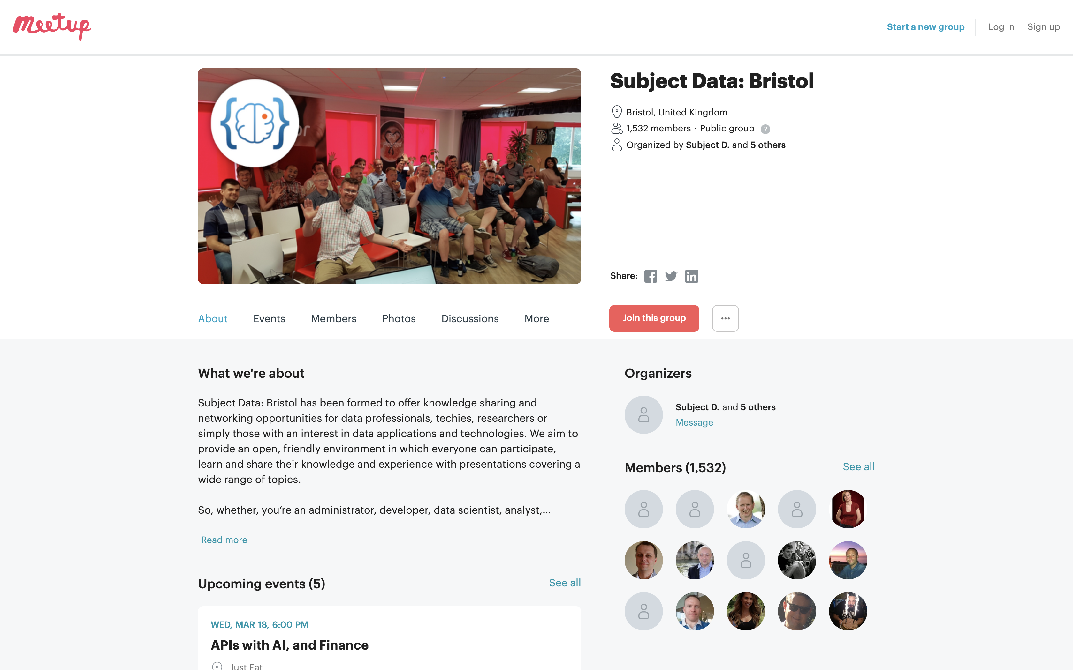
MEETups and Community Groups

Slide 5

Agenda: What are we going to do………
Refine data using Azure Data Bricks
Write JSON Data to Data Lake Gen2
Scala overview
Functional Programming
XML transformation to JSON
A BIT OF THEORY
PRACTICAL

Slide 6
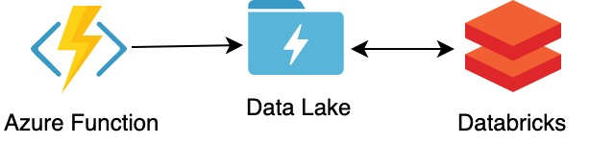
The (Real World) Problem
Third party API providing old school XML responses that need to be transformed into JSON and then:
Written to an Event Queue
2) Stored in Data Lake
https://github.com/AnnaWykes/scala-for-big-data

Slide 7

What is Scala
In its entity, Scala is a programming language that combines two quite distinct programming paradigms, containing the features of both object-oriented and function-oriented languages
What is Scala used for? A lot of things, ranging from machine learning to web apps. As a high-level general purpose language, Scala boasts an extensive range of possible applications.
The name Scala stands for “scalable language.” The language is so named because it was designed to grow with the demands of its users

Slide 9
The ultimate teaching language?
When deciding which programming language you should learn first, most will provide guidance towards Python or JavaScript noting their relative gentle learning curves. However, there is an upfront opportunity cost that is incurred by choosing one of those languages.
Those costs include:
The pool of programmers that you will compete with for jobs will be learning these same languages and you’ll fail to set yourself apart if you are not aware of their limitations.
Their dynamic typing can lead to extremely hard refactoring when working on large scale projects.
The fact that these languages are interpreted leads to performance costs.
Learning how to overcome these limitations and knowing when and where to choose a language or paradigm requires you to learn multiple languages upfront.

Slide 10






Who Uses scala

Slide 11
Software written in scala

Slide 12
Scala and Big Fast Data
“Scala has taken over the world of “Fast” Data”
Which is what some are calling the next wave of computation engines that rely more on the speed of data processing rather than the size of the batch, and the ability to process event streams in real-time.
Several prominent examples of that movement are Spark, Scalding, Kafka (including Kafka Streams), and Samza, which are rapidly gaining awareness and use

Slide 13
But still, why bother….
Professionals want to learn and use transferable, portable skills in their day job
Scala is multipurpose, meaning you can use if for anything from a simple web app to ML
Provides the opportunity to learn Functional Programming, allowing for easy transition into other languages such as Haskell, F# and even Erlang if you’re crazy enough
Competitive skill set
It has a solid community behind it
It is Type safe

Slide 14
Type Safety
Type safety means that the compiler will validate types while compiling, and throw an error if you try to assign the wrong type to a variable

Slide 15
Types safety means you can’t turn a cat into a dog

Slide 16
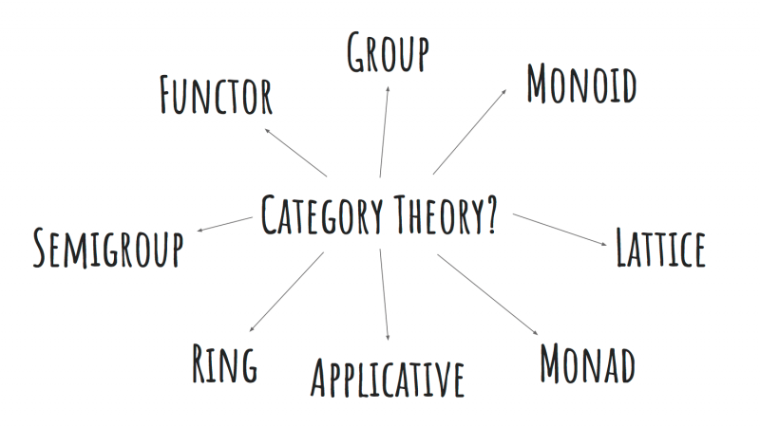
Functional Programming

Slide 17
Functional Programming: Monads
Step One
A Monad is a sequence of events with a get out of jail card
Step Two
Step Three

Slide 18
Apache Spark
Apache Spark is an open-source distributed general-purpose cluster-computing framework. Spark provides an interface for programming entire clusters with implicit data parallelism and fault tolerance

Slide 19
DataBricks is an organization and big data processing platform founded by the creators of Apache Spark.
DataBricks was founded to provide an alternative to the MapReduce system and provides a just-in-time cloud-based platform for big data processing clients.
DataBricks was created for data scientists, engineers and analysts to help users integrate the fields of data science, engineering and the business behind them across the machine learning lifecycle. This integration helps to ease the processes from data preparation to experimentation and machine learning application deployment.

Slide 21
Basics of Scala
Objects and Classes
Option
Lists
Map & FlatMap
Fold & Reduce
For Comprehensions

Slide 22
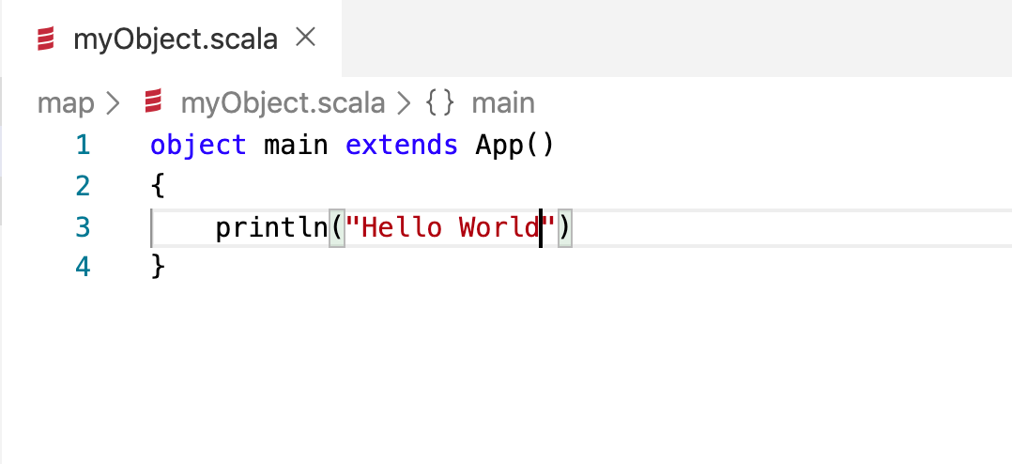
Objects
An object has exactly one instance (you can not call new MyObject). You can have multiple instances of a class.
Object serves the same (and some additional) purposes as the static methods and fields in Java/c#

Slide 23
Case classes
Good for modelling immutable data Act like blueprints

Slide 24
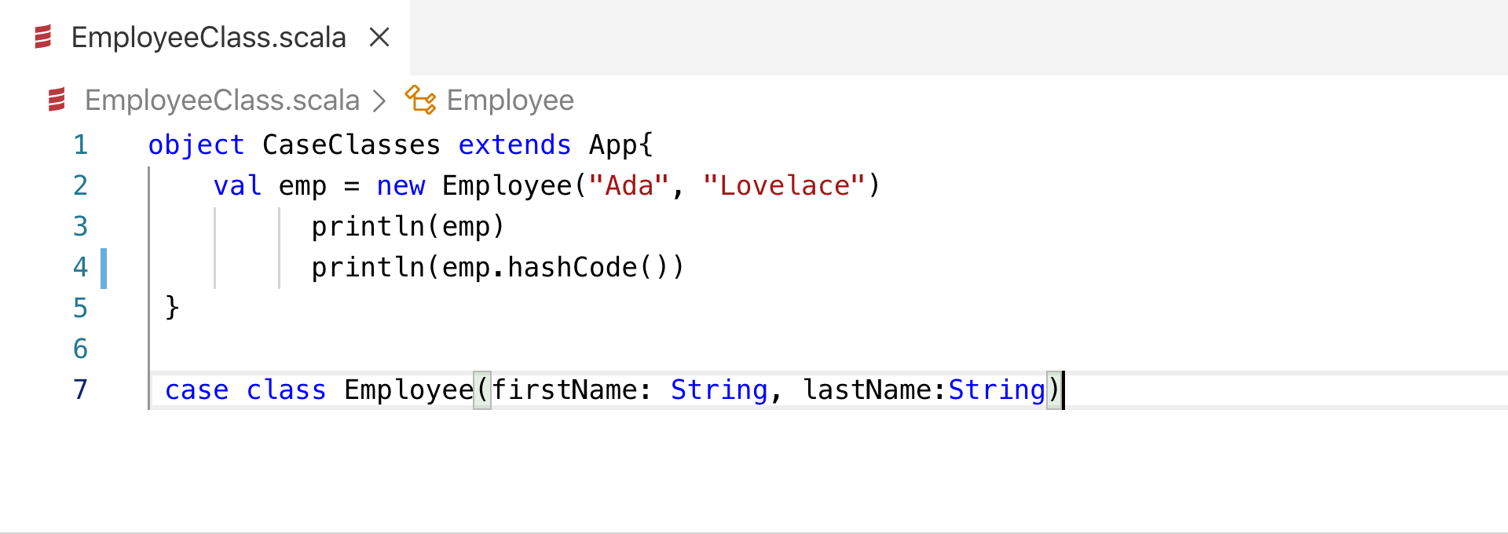
ObjecTs and Case Classes

Slide 25
Case Classes
Automatically-generated equals and hashCode methods, so instances can be compared
Has an automatically-generated copy method that’s extremely helpful when you need to perform the process of a) cloning an object and b) updating one or more of the fields during the cloning process
When you define a class as a case class, you don’t have to use the new keyword to create a new instance
An unapply method is generated, which lets you use case classes in more ways in match expressions.
A default toString method is generated, which is helpful for debugging

Slide 26
Case Classes

Slide 27
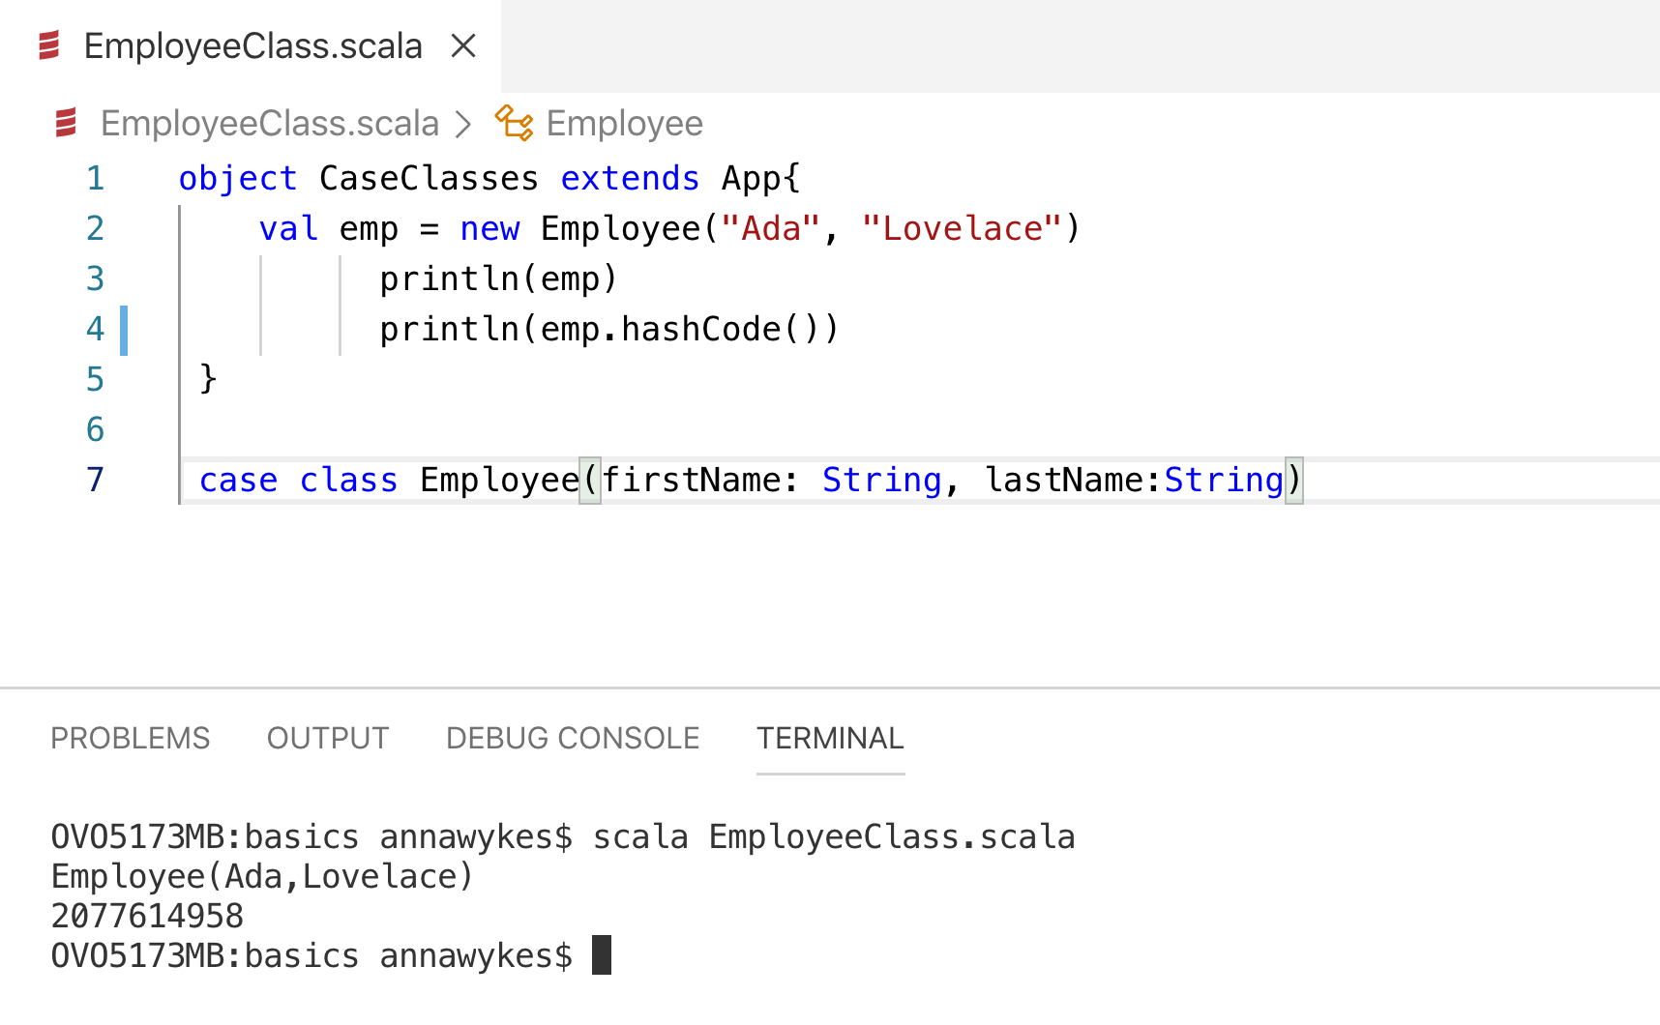

Slide 28
The NULL Mistake
“I call it my billion-dollar mistake. It was the invention of the null reference in 1965” — Tony Hoare, 2009

Slide 29
How does Scala handle Nulls: Options
A Scala Option holds zero or one element of a type. This means that it is either a Some[T] or a none object. One place we get an Option value is through the get() method for a Map
SOME = Something
NONE = Nothing

Slide 30
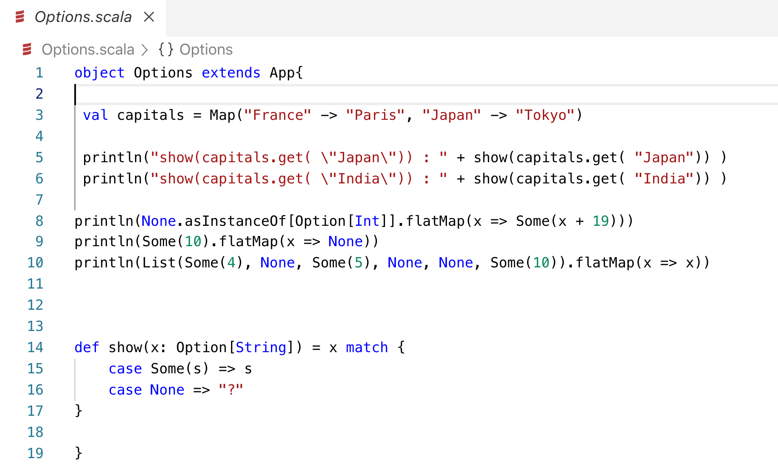

Slide 31
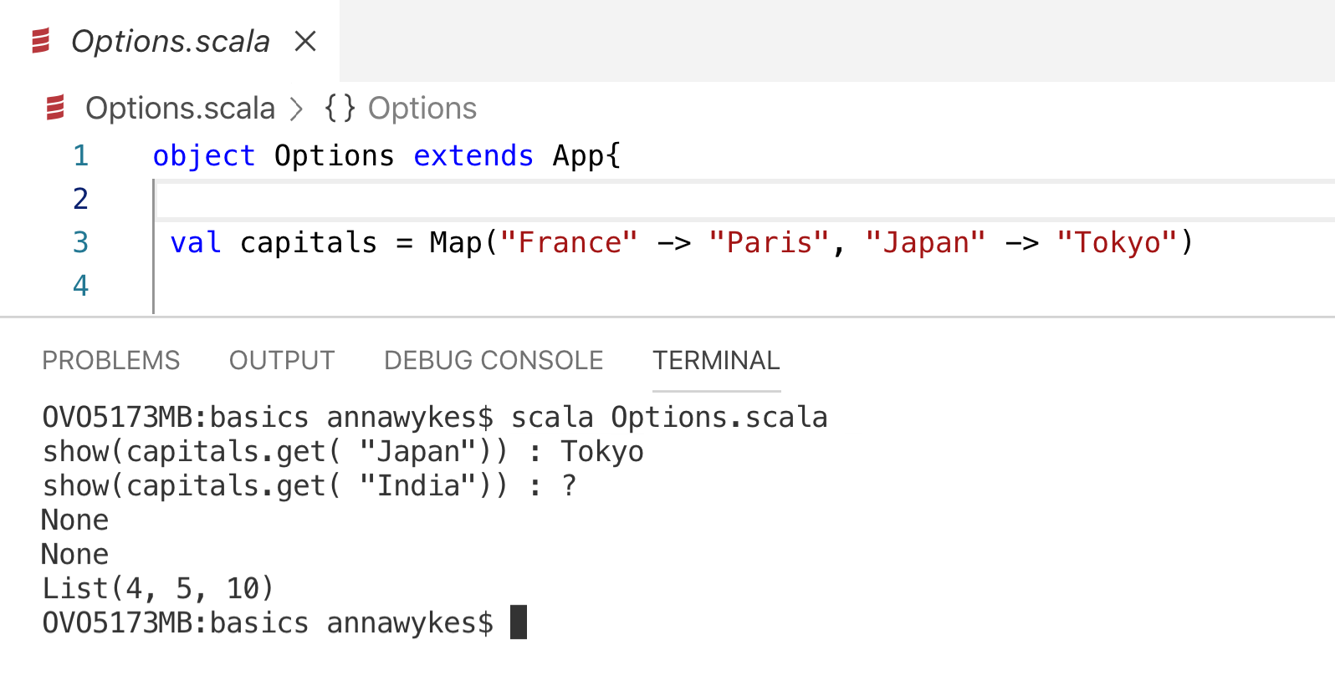

Slide 32
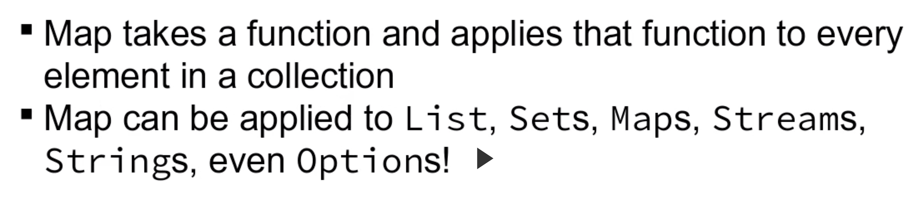
Function Map

Slide 33
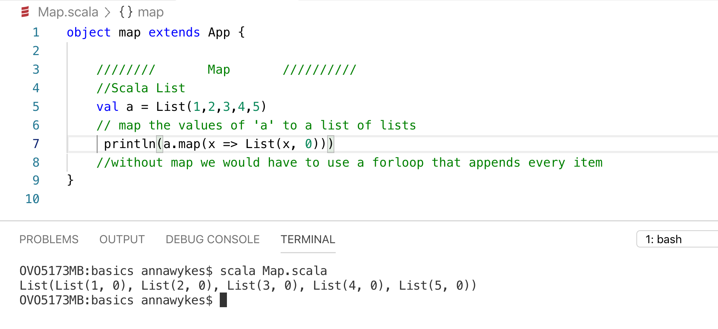

Slide 35
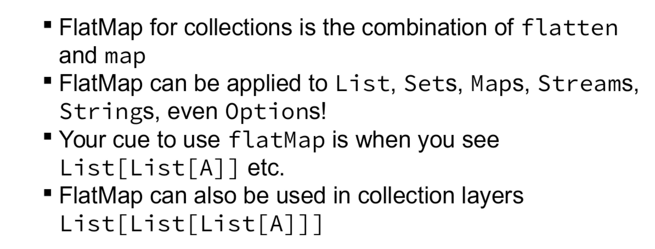
flatmap

Slide 36
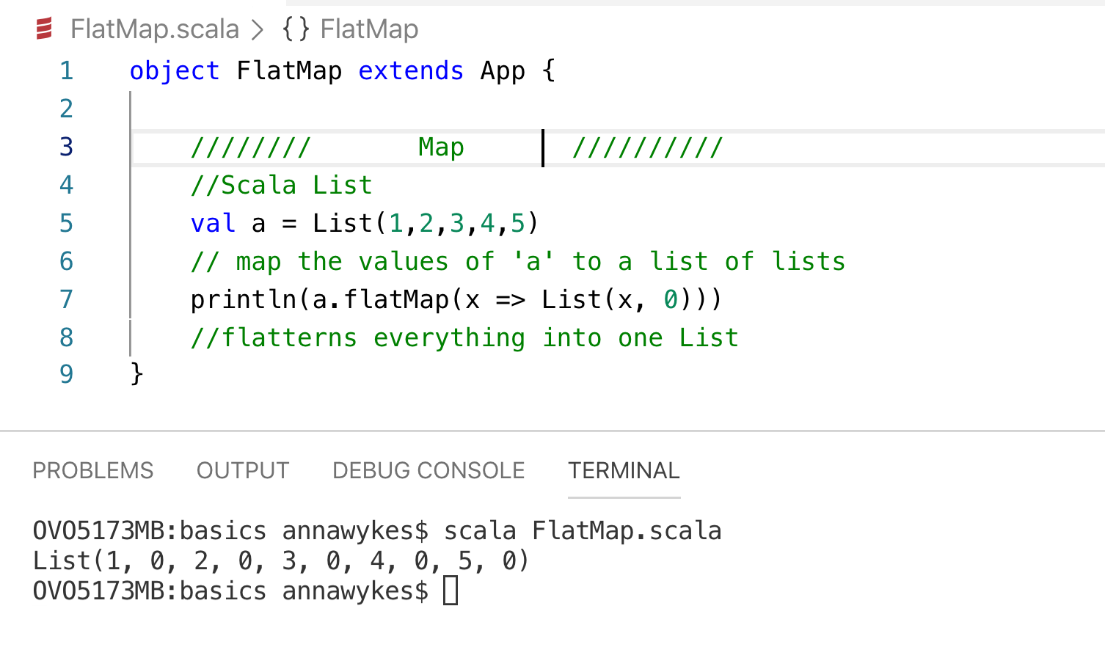

Slide 37
When you forget to use flatmap

Slide 38
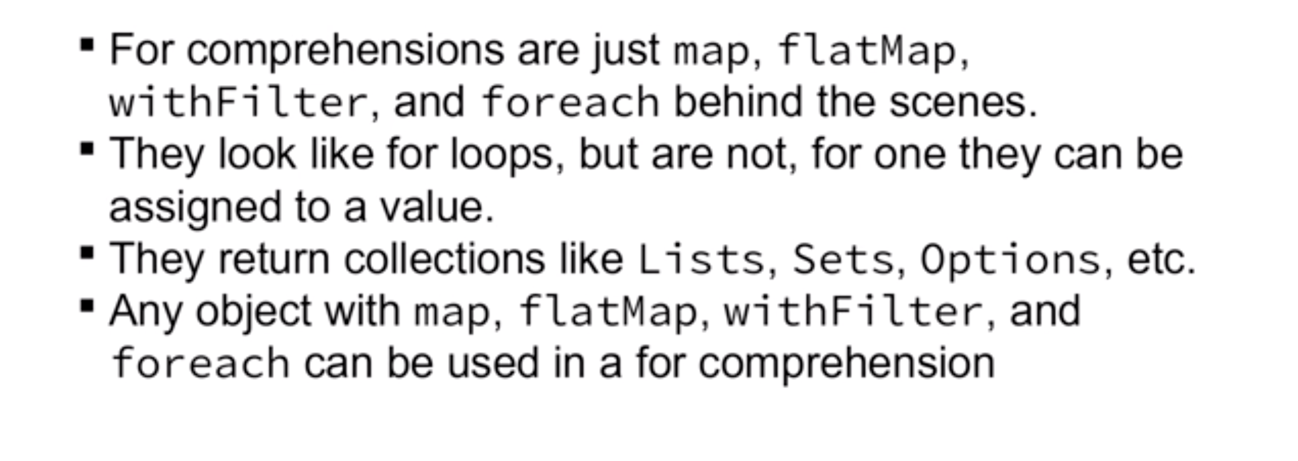
For Comprehensions

Slide 39
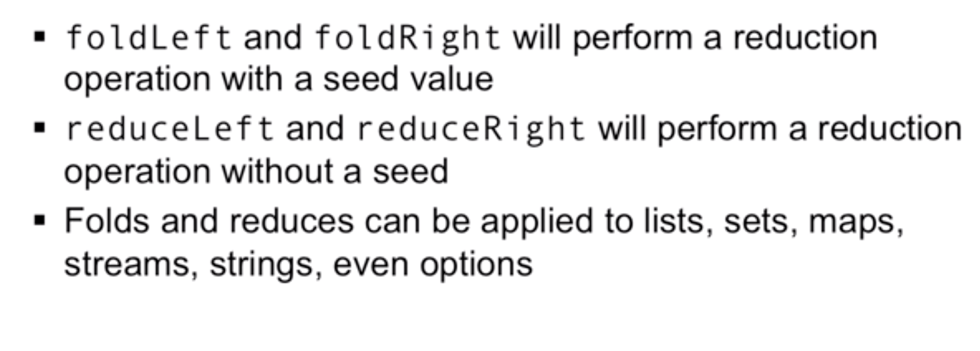
Fold, reduce & Filter

Slide 41
Demo Time: Azure Function
Read XML and ouput JSON using:
Azure Function
Monad (Functional programming style)
Make sure you have JDK 8 installed and your JAVA_HOME set appropriately.
Install .NET Core (needed for the local function host)
Install the Azure Function Core Tools (this will help you run and debug your function locally before deploying)
Install sbt
https://github.com/AnnaWykes/scalaforbigdata

Slide 42
Demo Time: Time to refine Our Data
Move data from raw folder in Data Lake into refined folder

Slide 43
Useful links
Learning
https://www.scala-exercises.org/
https://scala.epfl.ch/
https://www.coursera.org/specializations/scala
https://typelevel.org/cats/
https://medium.com/disney-streaming/tagged/thisweekinscala
Conferences
https://scaladays.org/
https://scala.world/

Slide 44
THANK YOU
https://github.com/AnnaWykes/scala-for-big-data
anna-maria-wykes-31939454
@annawykes

